Slide 1
FY15 Title I Completion Report Directions
CR Programs Details Section
GME System

Slide 2
Set Asides Table
In the table that follows, Budget Amounts are populated based on the last approved FY14 ESEA Consolidated application or amendment. Enter the Actual Expenses next to each budgeted amount. The system should calculate the difference between budgeted and actual.

Slide 3
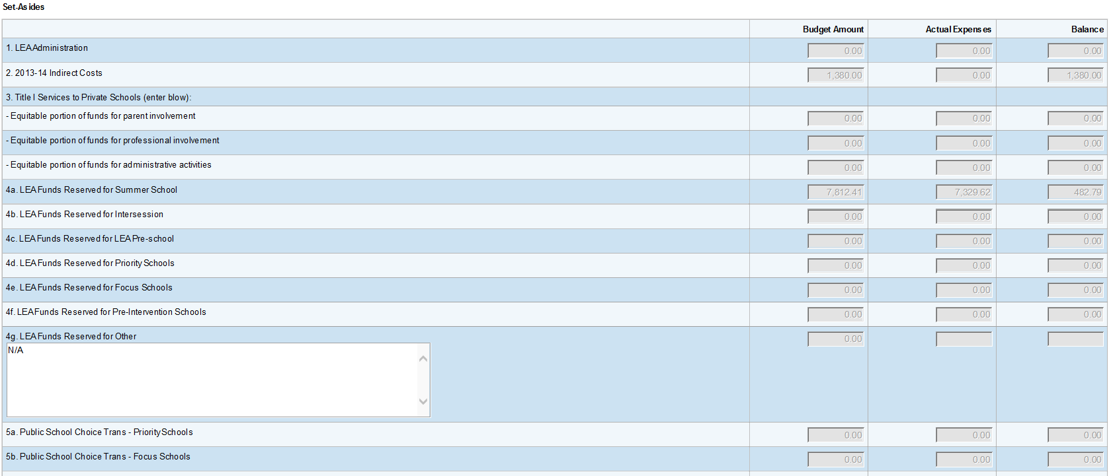
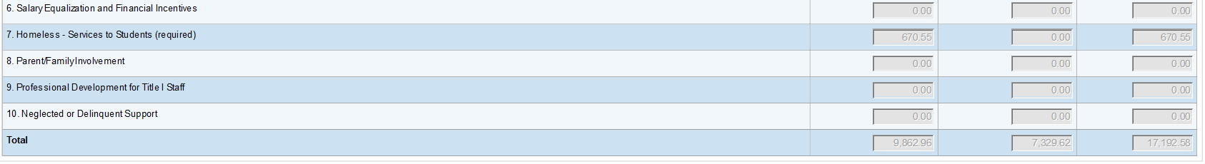

Slide 4
Discrepancies: Budgeted vs. Actual
In the text box below, explain any discrepancies between Budget Amounts and Actual Expenses in the Set-Asides table above.
As applicable, clearly identify each set aside by its name and, in particular, why required set asides were not fully expended.
Be as succinct as possible while providing a full explanation.

Slide 5
Services to Private Schools (does not apply to charter schools)
Complete the following two tables and justification text box, if applicable.

Slide 6
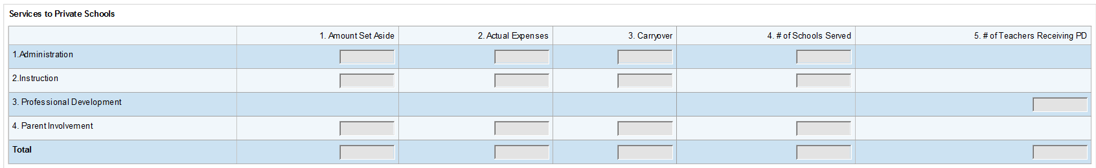
Title I Services to Private Schools
For each category in the table below, indicate the amount set aside from Title I for services to eligible private schools. Enter zeroes, if no amount was set aside.
NOTE: Column 5 pertains only to professional development (row 3).
If you did not set aside Title I funds for private schools, complete the justification that follows Private School Student Participation by Grade below.

Slide 7
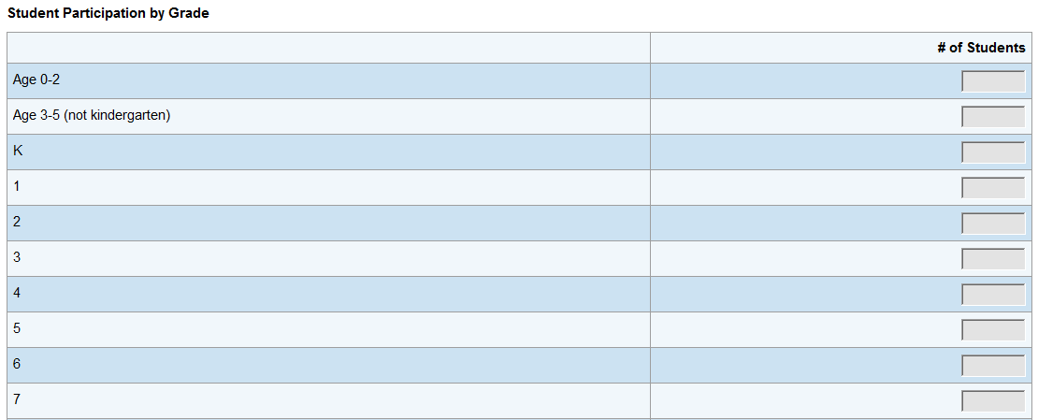
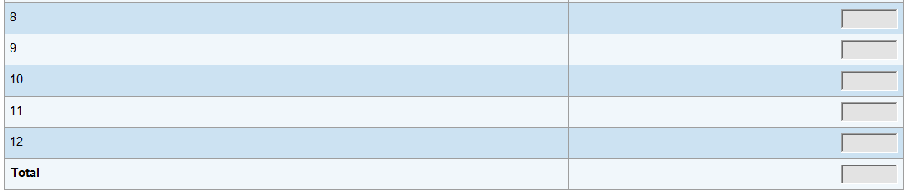
Private School Student Participation by Grade
Complete the following table, providing the total number of private school students served by the LEA in each category.

Slide 8
Justification - No Set Aside for Private Schools
If the full Title I set aside amount for Private Schools was not expended, complete the justification. Please indicate if you do not have participating private schools.

Slide 9
Parent Involvement 1% Set Aside Distribution
If your Title I allocation was greater than $500,000, you were required to expend at least 1% ($5,000 and up) on parent involvement activities. In addition, only 5% of the 1% of set-aside funds were permitted to be spent at the LEA level. The remainder must have been distributed to and spent at your Title I schools. NOTE: If your Title I allocation is less than $500,000, this set aside does not apply to your LEA.

Slide 10
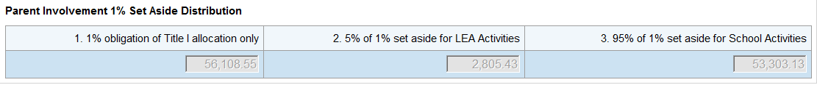
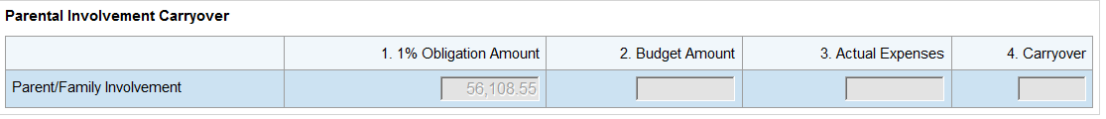
1% Obligation: The following is an example of obligated amounts for the parent involvement set aside ($500,000+ allocation).
Parent Involvement Carryover
Parent Involvement set aside funds must be tracked separately and any unused funds that are carried over must be spent within that program in the following year.
Column 1: Enter the 1% obligation of your Title I allocation for FY14.
Column 2: Enter the amount budgeted for parent/family involvement (can be more than the 1% required).
Column 3: Enter the amount actually expended for parent/family involvement.
Column 4: Enter the difference between the amount in column 1 (1% Obligation Amount) and the amount in column 3 (Actual Expenses).
If the amount in column 3 is less than the amount in column 1, the amount in column 4 (Carryover), must be carried forward to FY15 and used for parent/family involvement activities.

Slide 11
If your LEA had a Title I allocation of $500,000 or more, complete the following table for activities supported by the required 1% set aside indicated in the Parent Involvement Carryover table above. If you expended more than the 1%, do not include those funds in columns 1 and 2. Select all that were completed by the LEA or its Title I schools for the 2013-2014 school year.
The total under column 1 (district/charter holder expenditures) plus the total under column 2 (school-level expenditures) should equal the required 1% set aside amount. Note: The total for column 1 should not exceed 5% of the 1% set aside amount.
Enter any other federal, state, or local funds that were used in column 3. "Other Funds". Enter zeroes if none.
In column 4, enter the name of the school(s) that received the services listed.
Parent Involvement Activities - 1% Obligation

Slide 12
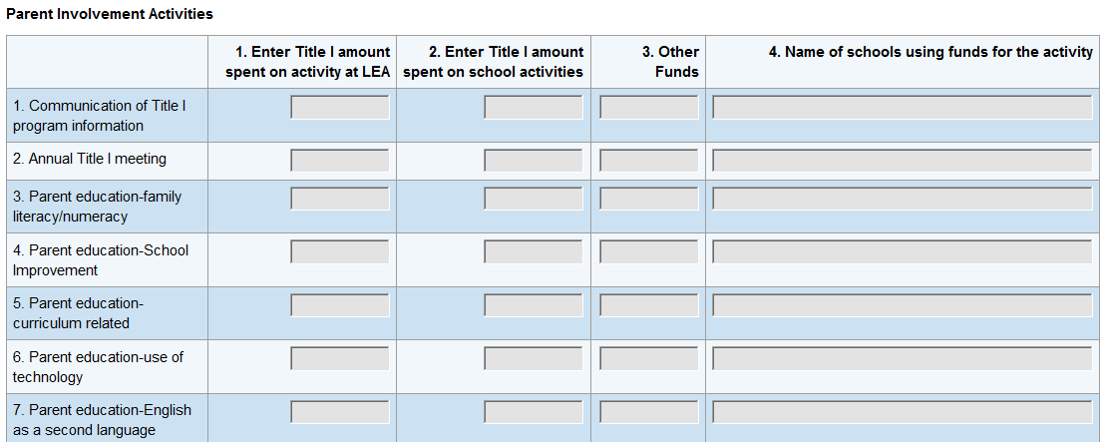
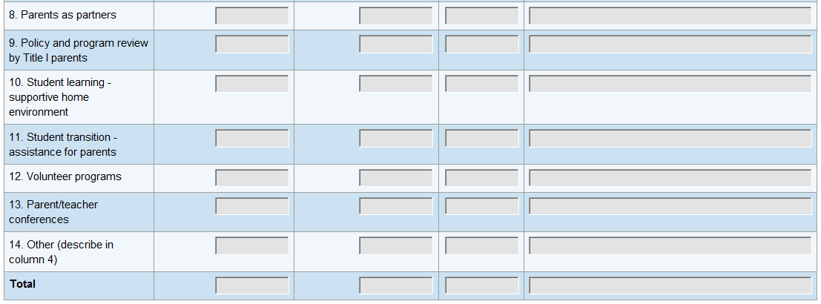

Slide 13
Public School Choice Set Aside
Arizona's ESEA Flexibility Request requires that schools identified as Priority or Focus must reserve a portion, as needed, of their Title I-A allocation for public school choice. Reminder: Students who participated in the SI Choice program should have been entered into SAIS.

Slide 14
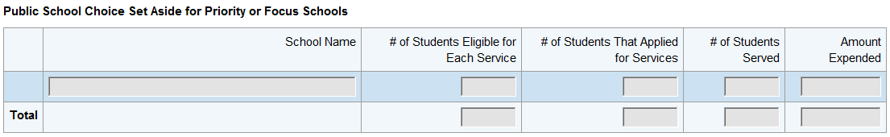
Public School Choice Set Aside for Priority or Focus Schools
In the table below, enter the amount set aside for Public School Choice for each of your schools. You will have the option to add rows.

Slide 15
Targeted Assistance Schools
Complete the following tables as they apply to your Targeted Assistance School(s).

Slide 16
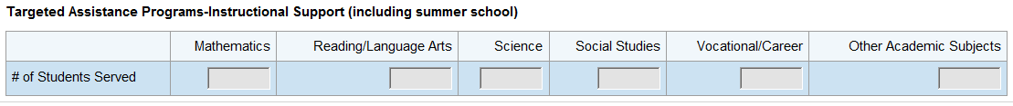
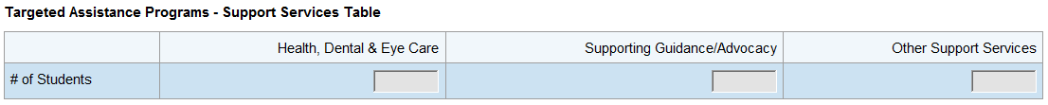
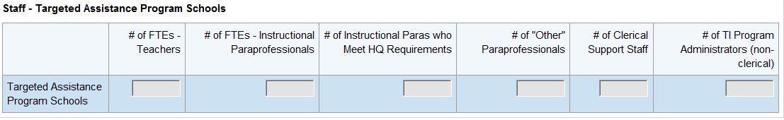
Targeted Assistance Instructional Support (including summer school)
Targeted Assistance Support Services
Staff – Targeted Assistance Program Schools
NOTE: These positions are for only those paid with Title I funds, including summer school staff. "Other": translation, parental involvement, computer assistance.

Slide 17
Schoolwide Program Schools

Slide 18
Staff – Schoolwide Program Schools
Complete the following table for your schoolwide program schools, if any, including summer school. Include ALL instructional paraprofessionals whether or not they are being paid out of Title I funds.

Slide 19
Title I-A – Neglected Students Served
Sect. 1113, (c)(3)(B) of the Elementary and Secondary Schools Act states that an LEA shall reserve funds as necessary to serve children in local institutions for neglected children.

Slide 20
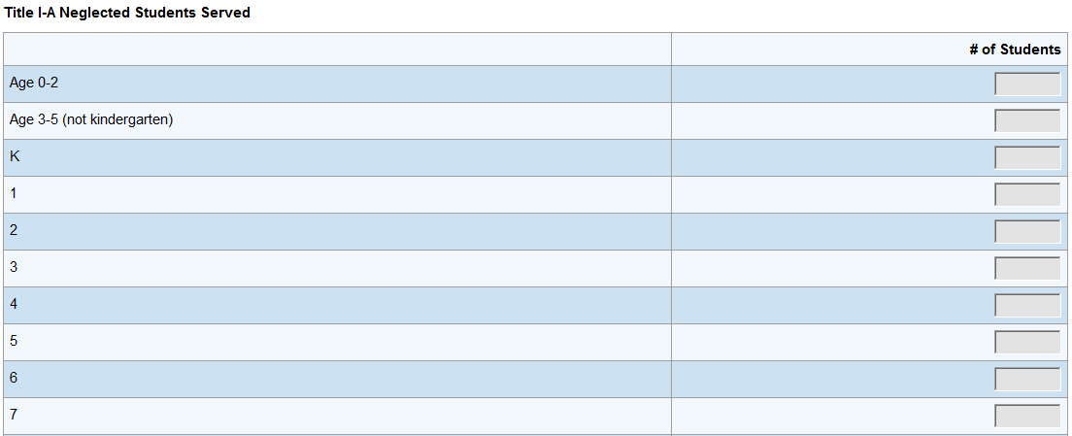
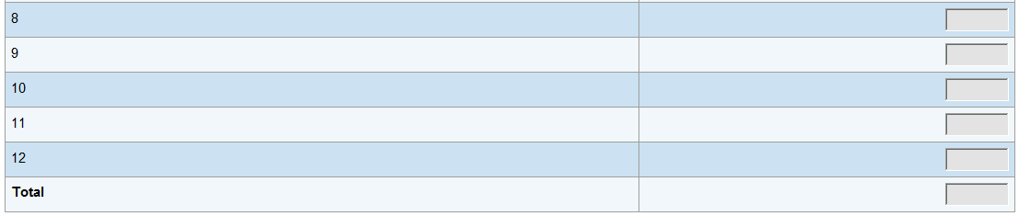
Complete the following table, providing the total number of local neglected students served by the LEA with Title I-A funding in each category.

